Slide 1
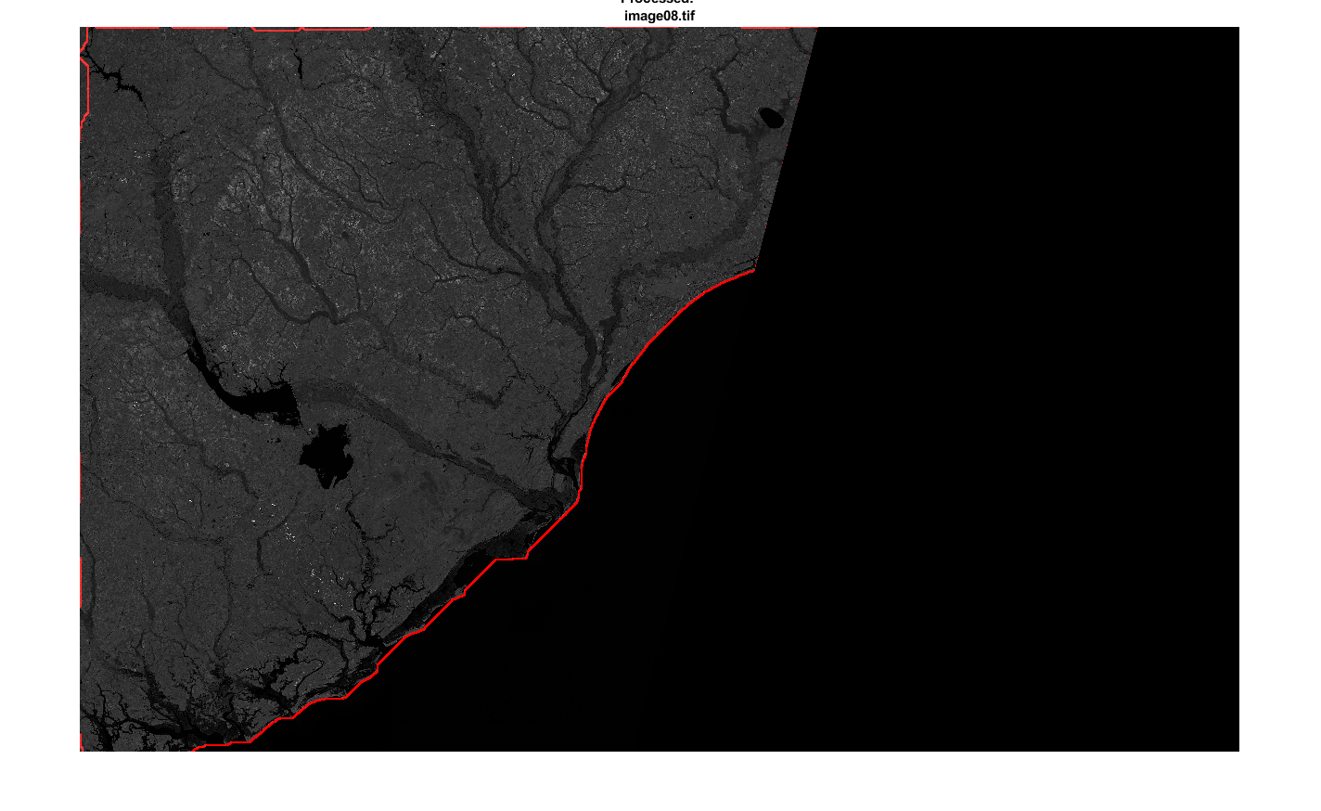
Project 3 Lakota Dolce

Slide 2
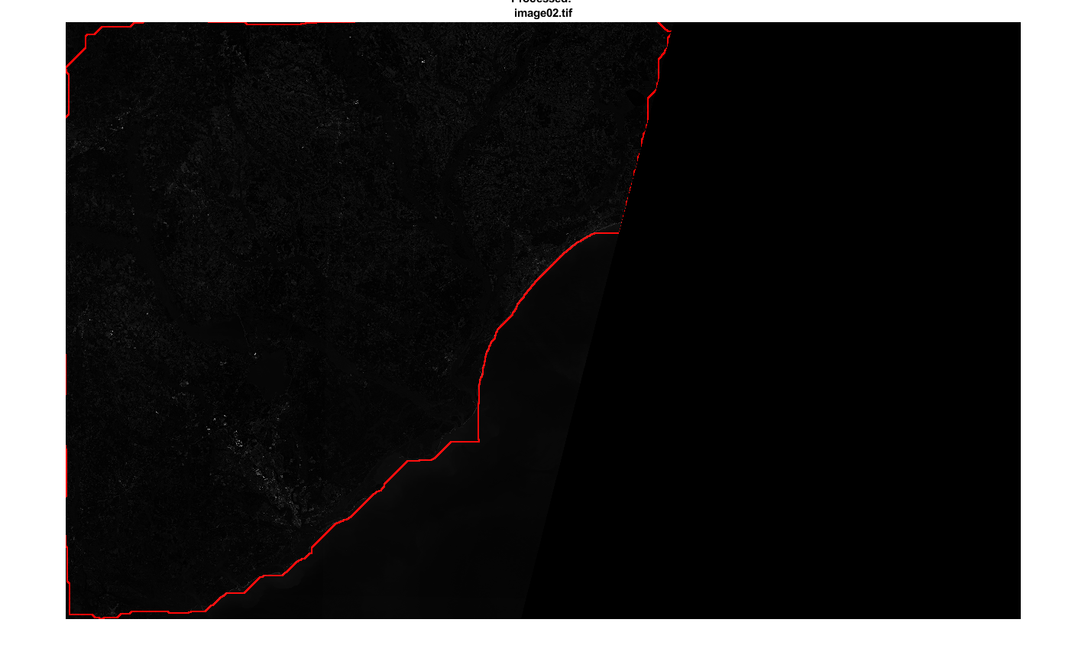
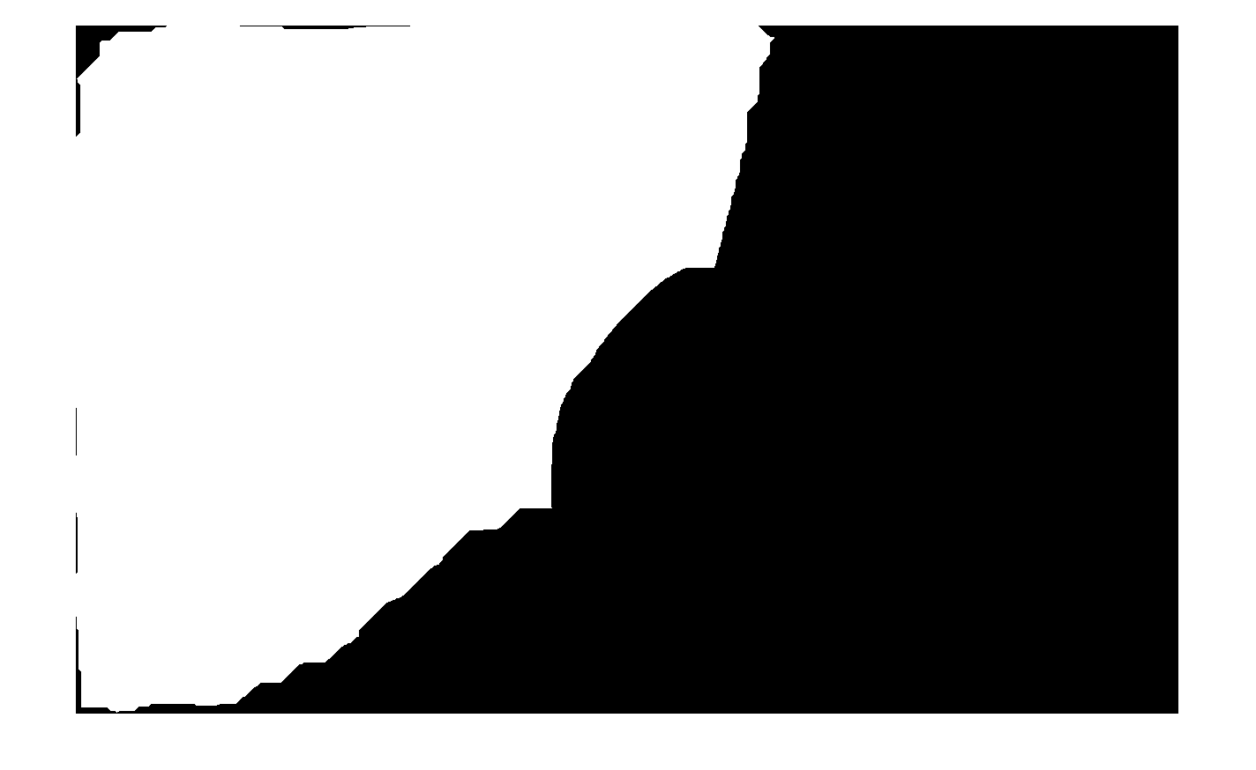


AGENDA
Issues that I faced
Darker images were harder as the thresholding sometimes thought shallow water was land
Determining the best way to do the edge of the shoreline
Separating the land mass from the ocean
The bottom right on images 23-32 with the reflective waves
Accuracy of the land mask
Edges of the image and mask areas
Image02 Final
Image08 Final
Image02 Land mask
Image04 Land mask
Image28
Image28 Land Map

Slide 3
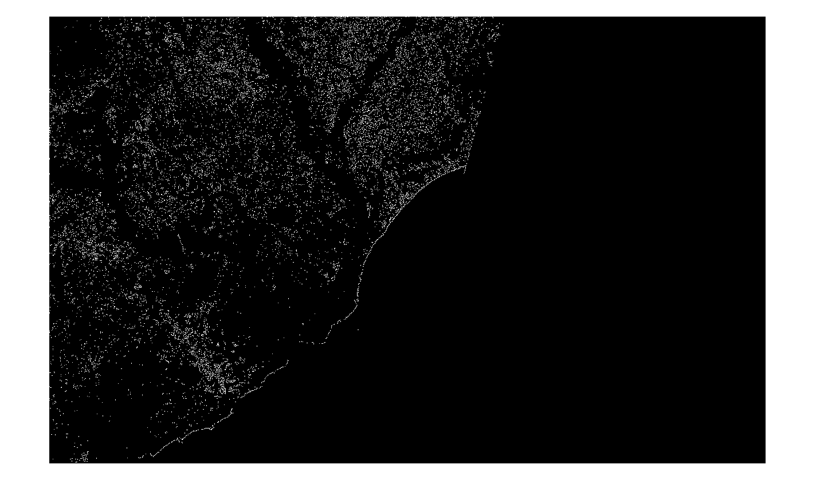
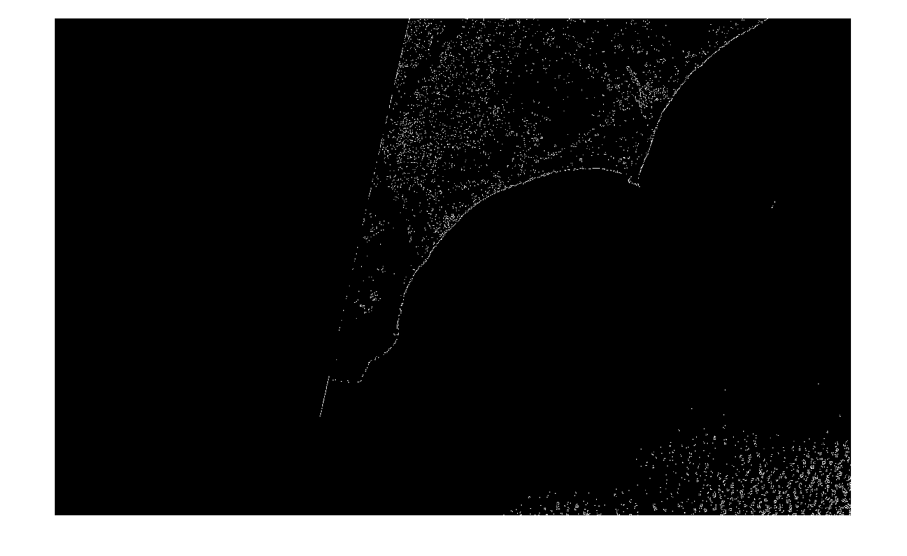
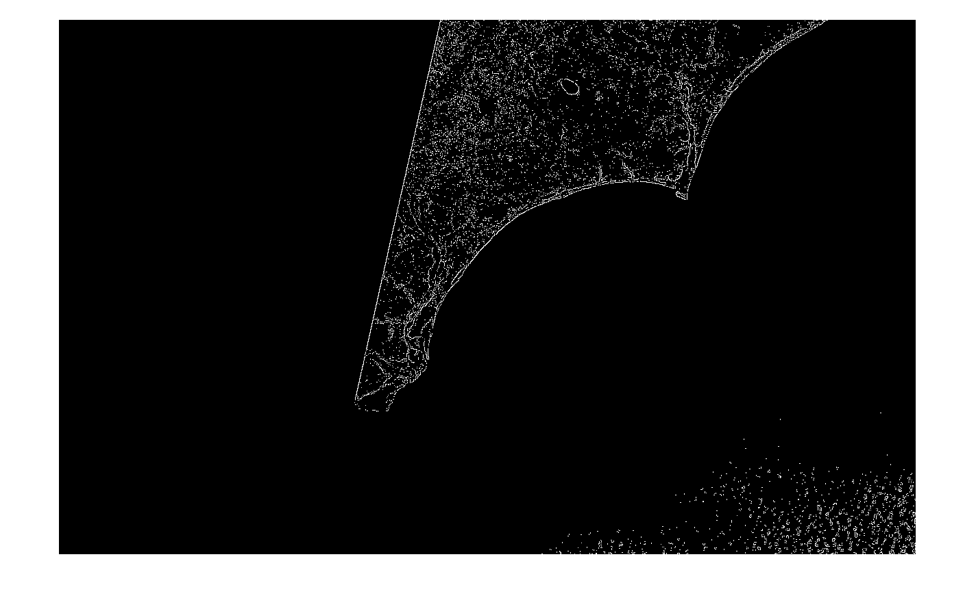
How I did it
Apply Otsu’s thresholding to get a BW image
Applying Sobel’s edge technique to solidify the land mass
Image02
Image22
Image28

Slide 4
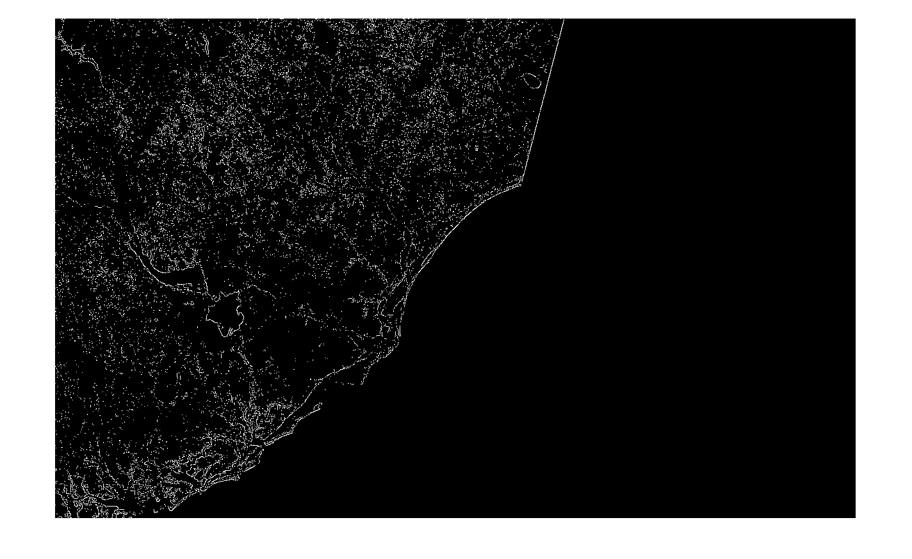

Next
I then used morphological closing and opening to turn the land into a solid block and to get rid of any noise in the picture
I continued applying and adjusting the morphological closing and opening until I got a good result on the binary mask
Image08
Image28

Slide 5
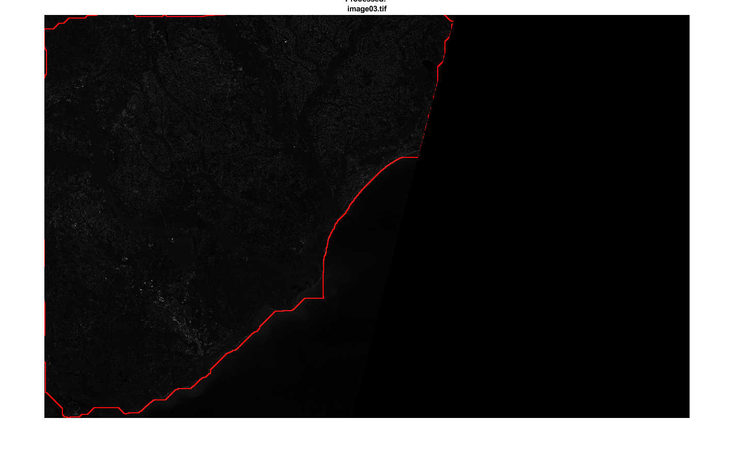
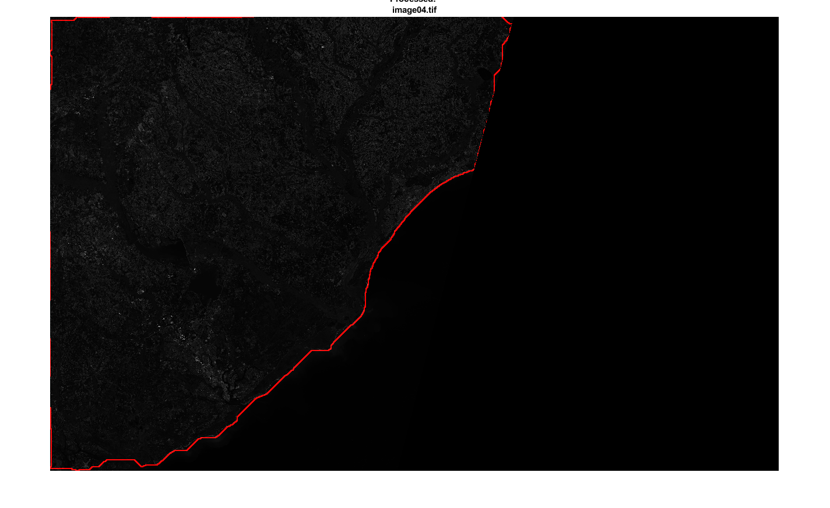
Finally
I used morphological dilation to identify where the shoreline
Created the RGB image
Highlighted the shoreline by separating the image into layers and changing the red layer using my mask created from the dilation process.
Image28

Slide 6
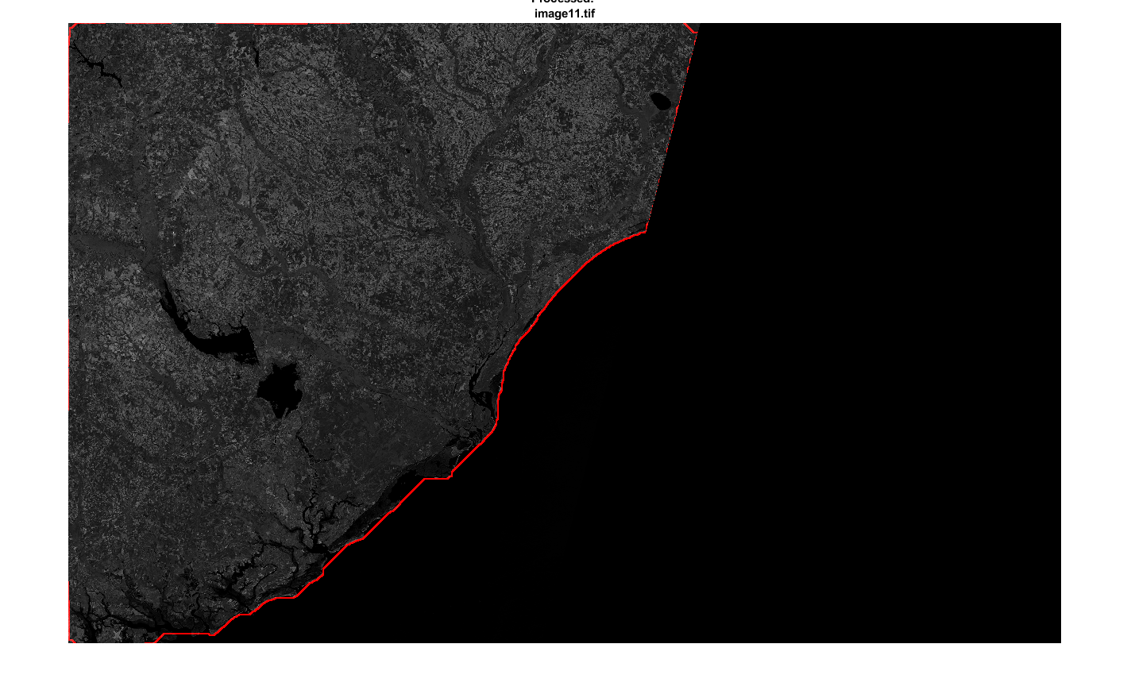
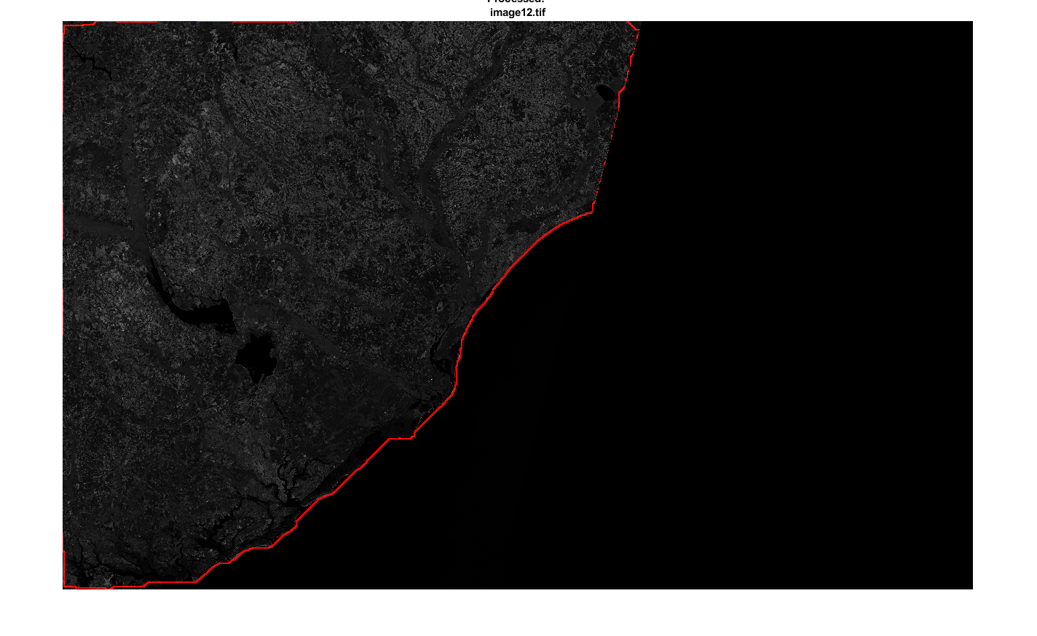
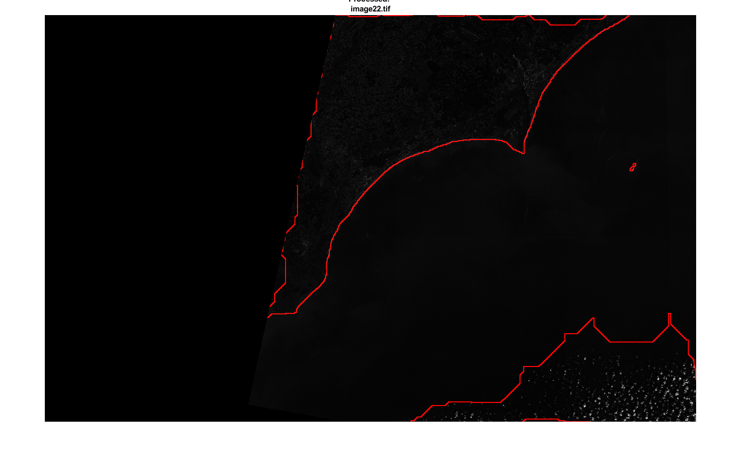
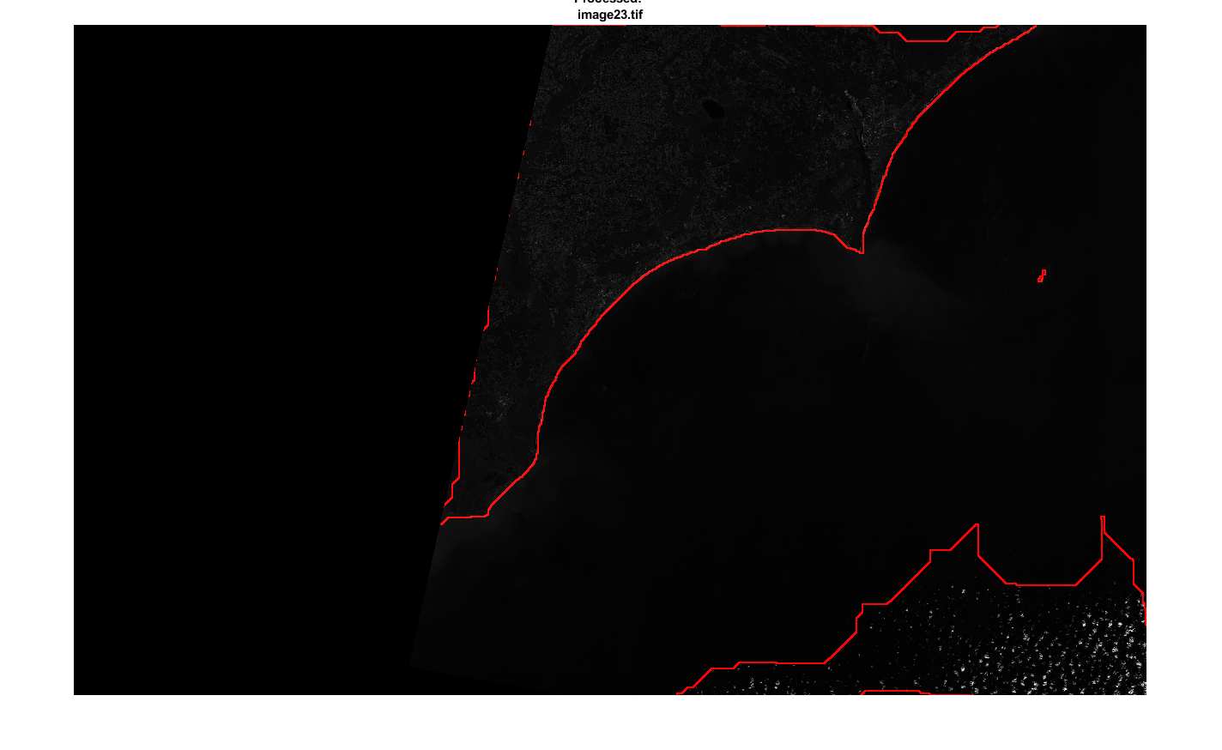
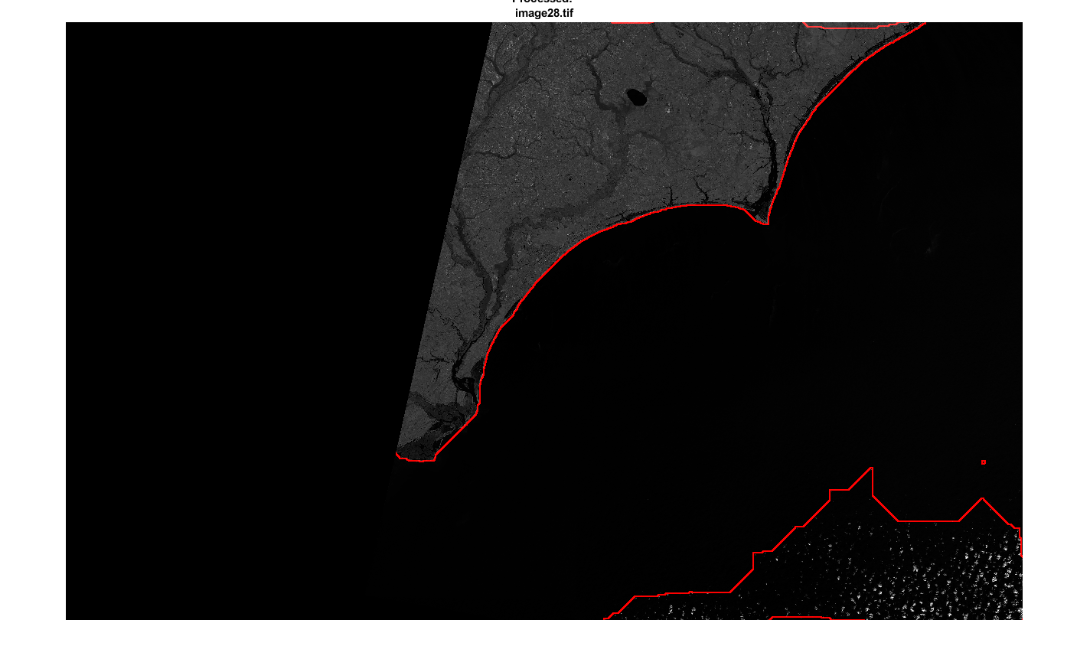
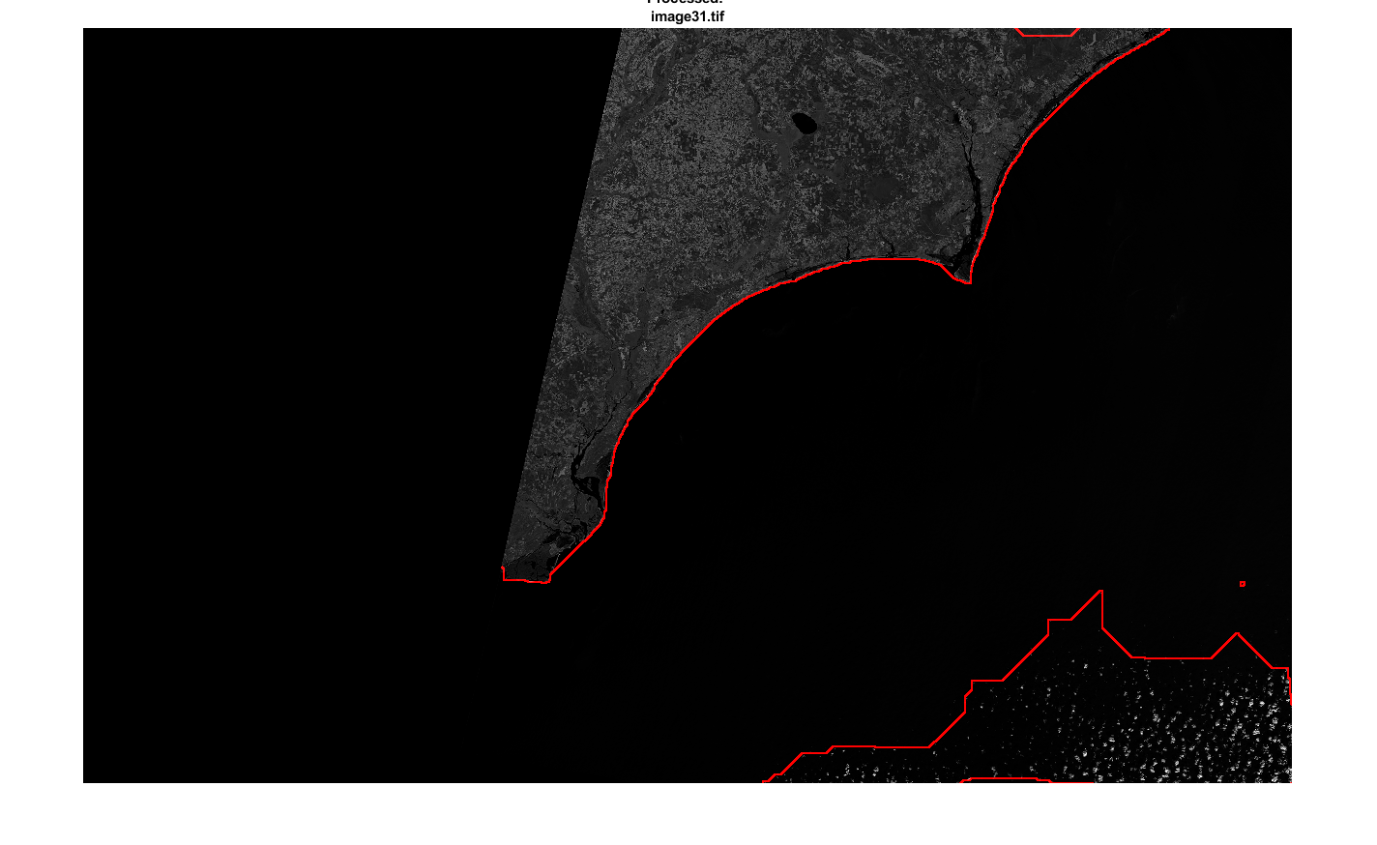
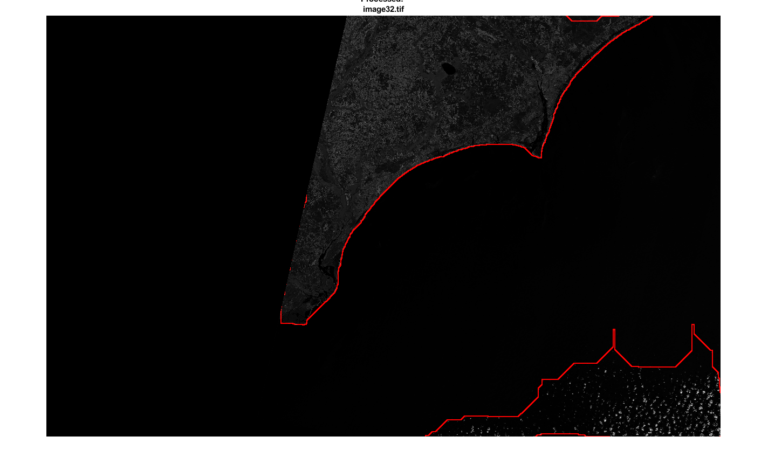
Image28

